Slide 1
MSB FALL KICKOFF · TEACHING WITH AI · AUGUST 26, 2026
AI Engagement for
Lifelong Learning
Not an AI fluency course. It teaches students to use AI like the 3 in 10 who get smarter, not the 7 in 10 who lose skills and motivation.
Mark Keith · Information Systems · 22 minutes
Notes:
0:00-0:45. One sentence of positioning and go. Students already have fluency; what they don't have is the engagement discipline that decides whether AI makes them smarter or hollows them out.

Slide 2
THE EVIDENCE · POOLED U3 ACROSS 30+ STUDIES
Short run: everyone wins
72%
Productivity · finish faster than the median non-AI worker
Noy & Zhang 2023, Science · Brynjolfsson et al. 2025, QJE · Peng et al. 2023
67%
Quality · produce higher-quality output inside AI's frontier
Dell'Acqua et al. 2023, 758 BCG consultants
62%
Individual novelty · produce more novel individual work
Doshi & Hauser 2024, Science Advances
varies
Equality · gap compresses for novices, can widen among experts
Brynjolfsson et al. 2025 · Kumar et al. 2024, ICER
U3 = the share of AI users who land above the median person who did not use AI.
Notes:
0:45-2:15. Concede the gains fully and fast. The argument is not that AI doesn't work. It works spectacularly while it's in your hand.

Slide 3
THE SAME STUDIES, AFTER THE TOOL IS REMOVED
Long run: most people lose
71%
Skill without AI · perform worse on solo tasks once AI is withdrawn
Bastani et al. 2025, PNAS · Budzyn et al. 2025, Lancet Gastro Hep
70%
Retention · retain less than non-AI peers on a 45-day delayed test
Barcaui 2025, RCT, N=120
69%
Motivation · less motivated on subsequent solo work
Wu et al. 2025, Sci Reports, N=3,562 · Fan et al. 2024, BJET
r < 0
Critical thinking · less critical evaluation effort with heavier use and trust
Gerlich 2025, Societies · Lee et al. 2025, CHI
About 7 in 10 end up worse off on their own than people who never used AI. About 3 in 10 end up better. Often in the same studies.
Notes:
2:15-4:00. Land the 70/30 line and pause. If asked about U3: assumes roughly normal distributions, a translation aid, not an exact rate. Gains and costs are the same magnitude and often the same people.

Slide 4
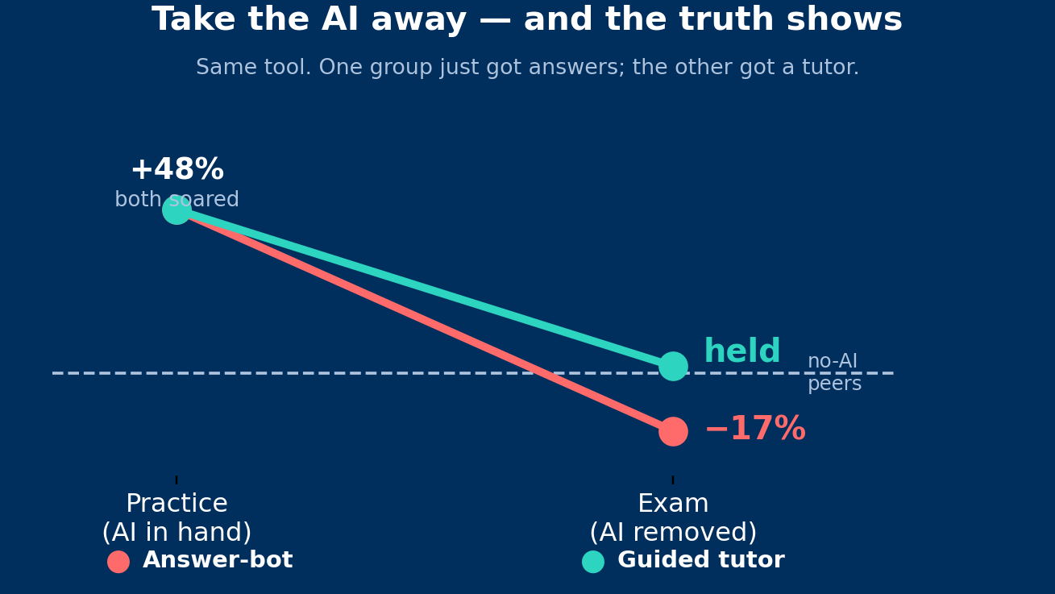
BASTANI ET AL. 2025 · PNAS · RCT, ~1,000 STUDENTS
The same students, the same AI. The answer-bot group soared +48% in practice and fell 17% below never-users on the exam. The tutor design eliminated the harm. Engagement design decides the outcome, not the tool.
Notes:
4:00-5:30. The single most important study for the argument. Walk it slowly: +48 during practice, -17 on the unaided exam, and the guardrailed tutor held. This is the course's design philosophy in one chart.

Slide 5
SO THE DEBATE MOST CAMPUSES ARE HAVING
is the wrong question
“Should students use AI?”
1
2
How should you
engage with AI?
What do you do with
the time it saves you?
Every finding on the previous three slides sorts people by their answers to these two questions.
Notes:
5:30-6:30. The pivot slide. 92% already use it; abstinence trains nobody. These two questions organize the rest of the talk and the course.

Slide 6
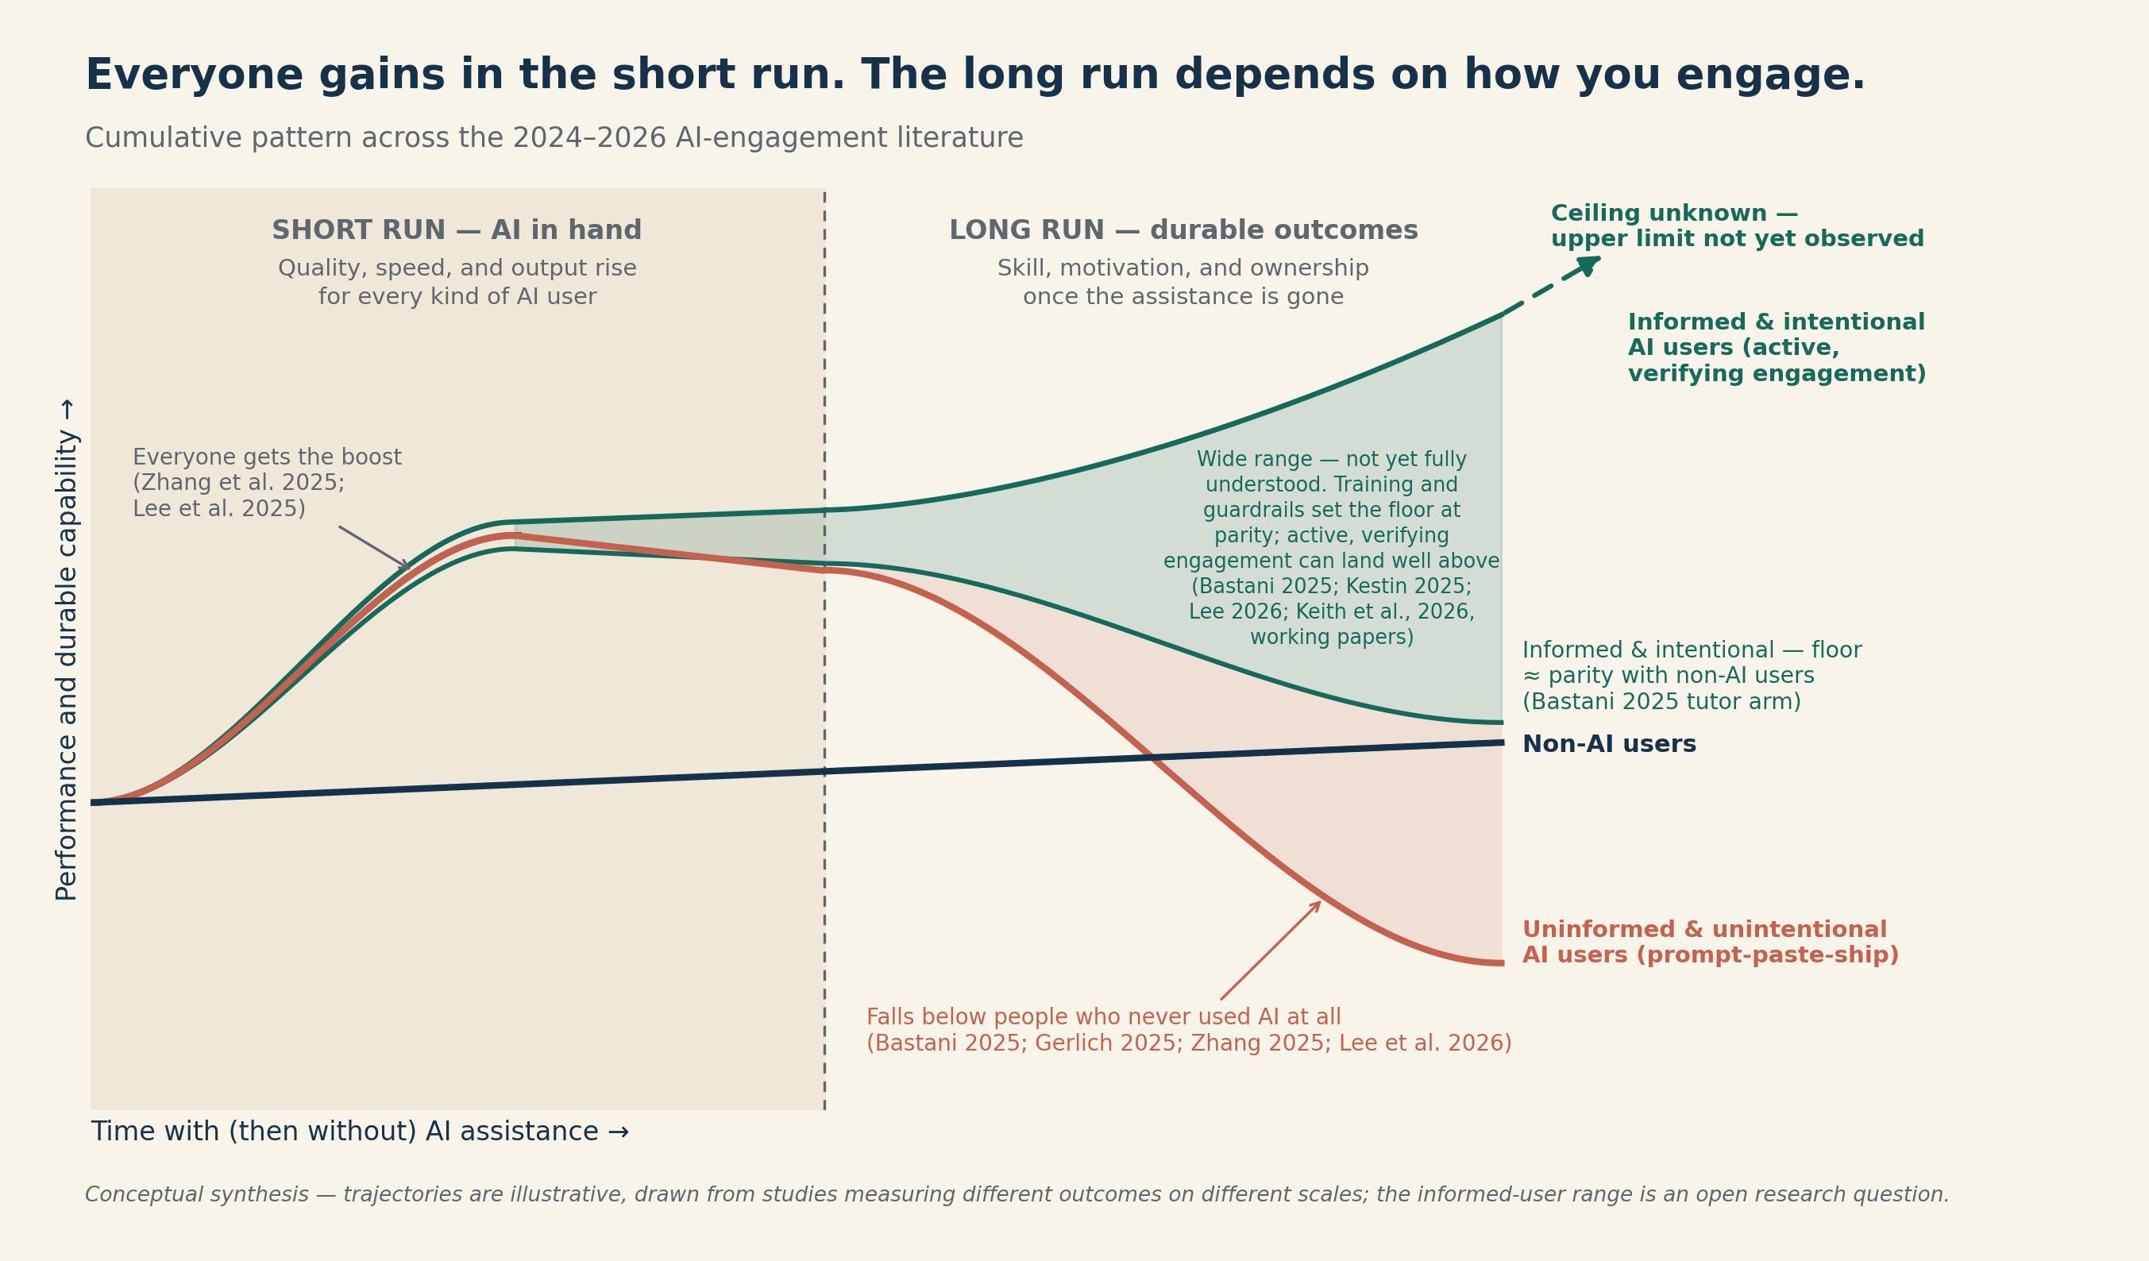
QUESTION 1 · HOW YOU ENGAGE
Same tool, three trajectories
Notes:
6:30-8:00. The chart from the LinkedIn post. Everyone rises while AI is in hand. When assistance is gone: informed, intentional users keep climbing with a floor at parity; uninformed users sink below people who never used AI. The green band is the 3 in 10. How you engage picks your line.

Slide 7
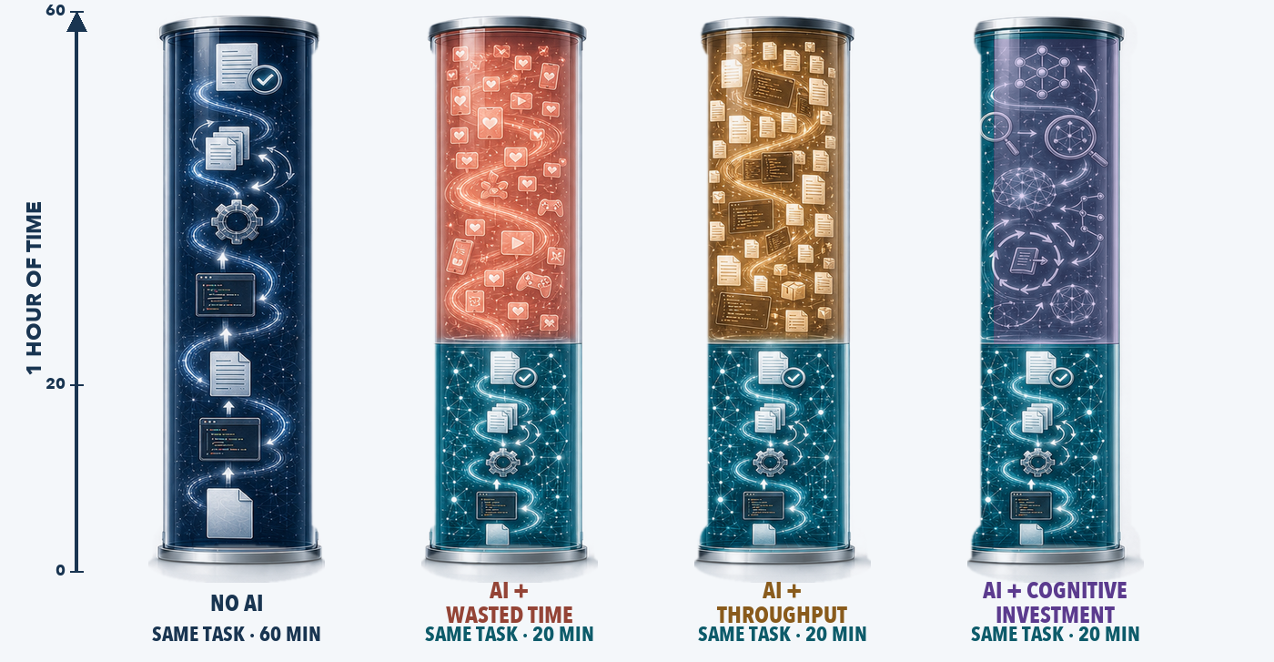
QUESTION 2 · THE HOURS AI HANDS BACK
The same hour, four futures
create · struggle · learn
scroll · swipe · avoid
more output, same skill
reflect · verify · adapt
What are you doing with the time AI saves you?
Notes:
8:00-9:00. Figure from the 2026-08-23 cognitive-investment LinkedIn post (visual-combined-v6, vessel band; source: 7-Social Media/LinkedIn/Posts & Assets/2026/2026-08-23_cognitive-investment). Same task in every vessel. Without AI it fills the hour; with AI it takes twenty minutes, and the other forty become the fork: the feed, more of the same output, or cognitive investment. AI doesn't eliminate struggle, it relocates it. The full post adds a conceptual 70/20/10 distribution strip; that split is an extrapolation, label it conceptual if asked.

Slide 8
WHERE THE AIEM COMES FROM
Old disciplines, new problem
Virtue tradition
Planned behavior
Aristotle: stable dispositions produce practical wisdom, which produces right action. In the AIEM, the modes are that action layer: the mode you reach for reveals the dispositions and principles behind it.
Ajzen 1991: dispositions drive behavior through mediating principles, tested in 2,000+ studies. It is why the AIEM predicts mode choice from dispositions through principles, not from personality straight to behavior.
Self-determination
Cognitive continuum
Deci & Ryan: psychological needs shape motivation, then behavior. It explains why passive modes that remove challenge drain intrinsic motivation while agency modes protect it.
Hammond 1996: cognition runs from intuitive to analytic, and AI's fluent output pulls users to the intuitive pole. The tiers map the continuum: passivity rides intuition, agency forces the analytic shift.
Reflective practice
Offloading & vigilance
Schön 1983 · Dreyfus & Dreyfus 1986: reflection and the novice-to-expert path. Problem Setter is Schön's problem-setting made into a mode, and Passivity-to-Agency mirrors novice-to-expert growth.
Risko & Gilbert 2016 · Sperber et al. 2010: offloading is strategic or corrosive, and AI bypasses evolved filters. Oracle is unexamined offloading; Verification and Challenger restore the vigilance.
Notes:
9:00-10:15. One breath per card, second sentence is the AIEM hook. The point for a faculty room: this is not a hot take on prompting. It is old, tested theory pointed at a new tool.

Slide 9
THE BEHAVIORS LAYER
Eight modes, three tiers
AGENCY · YOU DRIVE
5
Verification Agent
6
Creative Expander
7
Critical Challenger
8
Problem Setter
check claims, calculations, sources, assumptions
generate possibilities beyond the obvious
stress-test and strengthen your own reasoning
reframe the problem before solving it
PARTNERSHIP · THINK TOGETHER
3
Tutor
4
Collab. Problem-Solver
Not a ladder
seek genuine understanding, not answers
work it together, reasoning at every step
Oracle is correct for a bounded lookup. The skill is range and fit-to-task, matching the mode to what the task demands. And the tool never determines the mode. The same chat window can be Oracle or Critical Challenger. Your stance decides.
PASSIVITY · AI THINKS
1
Oracle
2
Production Assistant
accept output as authoritative, minimal evaluation
draft, edit, summarize under direction
Notes:
10:15-12:00. The instrument behind aimodes.ai measures these eight. Fit-to-task, never 'more agency is better.' Forcing high modes everywhere is itself a miscalibration.

Slide 10
ONE WAY THROUGH A REAL PROBLEM
The modes in motion
STEP 1
8
STEP 2
1
STEP 3
3
STEP 4
6
Problem Setter
→
Oracle
→
Tutor
→
Creative Expander
Am I solving the right problem?
Look up the bounded facts I need
Learn the concepts I am missing
Generate options beyond the obvious
↓
STEP 8
2
STEP 7
5
STEP 6
7
STEP 5
4
Production Assistant
←
Verification Agent
←
Critical Challenger
←
Collab. Problem-Solver
Produce the deliverable, last
Check every claim and number
Attack my own conclusion
Work the analysis together
One defensible path, not the path. Notice what it inverts: the question gets set before any answer is fetched, and production comes last, after the thinking survived challenge and verification. Most people start at step 8 and stop.
Notes:
11:15-12:15. Walk the snake: top row left to right, down, bottom row right to left. The inversion to land: produce LAST. Students default to starting with Production Assistant; this path ends with it. Different problems reorder the middle; the discipline is choosing the order deliberately.

Slide 11
THE THEORY THAT TIES IT TOGETHER
A four-layer serial mediation model
DISPOSITIONS
PRINCIPLES
MODES
OUTCOMES
Who you are when you sit down
The commitments you hold
The behaviors you enact
What you become
→
→
→
Intellectual humility · tinkering · tolerance for ambiguity · internal locus of evaluation · investment in process
Authorship · voice · productive friction · metacognitive reflection · calibrated trust
The eight modes, from Oracle to Problem Setter
Skill vs. atrophy · retention · motivation · calibration · dependency
Each layer works through the next: dispositions express as principles, principles select modes, modes produce outcomes. Moderated by expertise, context, and AI literacy. Same serial structure as the Theory of Planned Behavior, which is why it is testable.
Notes:
12:00-13:30. This is the formal model the empirical papers test. Dispositions are who you are; principles are what you're committed to; modes are what you do; outcomes are what you become. The course intervenes at the principles and modes layers because those are teachable.

Slide 12
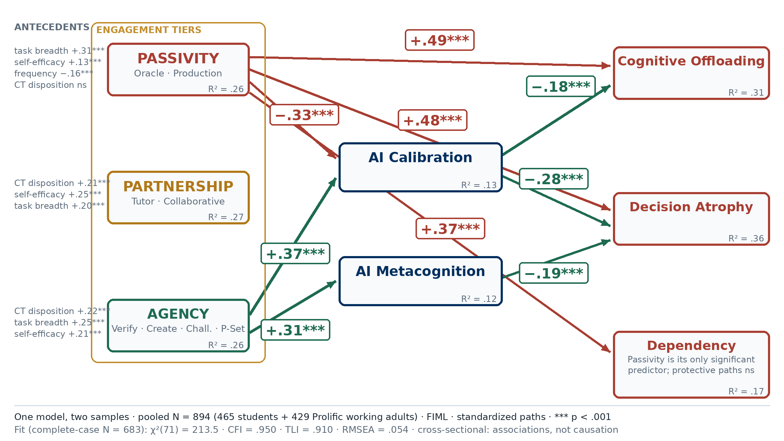
THE MODEL, TESTED · STUDENTS + PROLIFIC WORKING ADULTS
One model, two samples
Notes:
13:30-15:30. One model, two samples, N=894 (465 students, 429 Prolific working adults), FIML, CFI .950. Walk three paths only: passivity to offloading +.49; agency to calibration +.37 and metacognition +.31; calibration to decision atrophy -.28. If probed on the eight modes individually: in a separate N=334 sample, seven of eight modes tied productivity to dependency; Verification alone broke the pattern. Say cross-sectional out loud.

Slide 13
THE COURSE, IN SIXTY SECONDS
AI Engagement for Lifelong Learning
NUMBERS
MSB 200, 1 credit · MBA 693R, 1.5 credits · Fridays, two sections: 12:00 and 1:00
WEEKS 1-4
I teach the AIEM: the evidence, the eight modes, the active habits, and the first live case activities
THE LAST 10 FRIDAYS
Your program's day. Each program shows students what its discipline becomes in an AI world, and makes its case as a major
RHYTHM
Recognize → Rehearse → Live Activity → Perform. Only Perform is graded, and the complete AI conversation is the submission
ENGINE
aimodes.ai classifies every submitted conversation on the eight modes, with instructor review and grade write-back
Notes:
15:30-16:45. The structural pitch: four weeks of AIEM foundation, then the course becomes the school's shop window. Every program gets a Friday in front of every student. That is the recruiting channel.

Slide 14

TO MAKE YOUR FRIDAY WORK
Three things I need from your program
1
Content for the pre-reading
A document, slides, or content set summarizing what you will teach on your day. I add it to the course text as required reading before your class, so students arrive primed.
2
45 minutes on your Friday
Claim one of the 10 program Fridays on the signup sheet (QR). You present twice, back to back: the 12:00 section and the 1:00 section.
CLAIM YOUR FRIDAY
Google Sheets signup
10 dates - name + program
3
One AI-agent assessment
An assessment students perform with an AI agent that demands critical thinking, problem framing, creativity, and verification of AI output, and leaves them with the best possible picture of what your discipline is about.
Notes:
16:45-18:00. Say the payoff line: your day reaches every student in both sections, and the pre-reading plus the assessment live on in the course text. The recruiting pitch turned concrete. Dates run October 2 through December 11, Thanksgiving excluded; two sections at 12:00 and 1:00 on each date. If a program wants help designing the AI-agent assessment, that is exactly what I build; offer it.

Slide 15
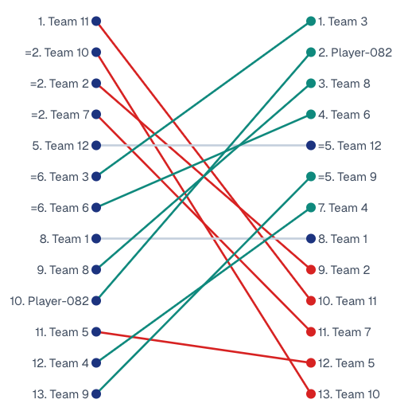
HOW IT TEACHES · ONE ACTIVITY, DESCRIBED
Cabana: the Incentive Trap
1
The brief: Leadership wants sign-ups maximized. Execution, not debate. Eight minutes, their own AI.
A REAL COHORT · THE FLIP
2
The visible board: Ranks creativity, projected success, completeness. Rewards fast, confident polish. A winner is celebrated.
3
The reveal: Tenure is 2 months. Each sign-up loses $34.17. 82% already churned. The number was in a column nobody opened.
4
The flip: The board re-sorts on the hidden score: who interrogated the objective, found the economics, reframed the mandate.
5
The mirror: Each student sees their own eight-mode profile: who verified, who challenged, who produced beautifully polished loss.
Initial rank (left) re-sorted by the revealed metrics (right). Green climbed by testing the premise; red fell with it.
The plan most participants build would pass review in most organizations. That is the lesson: good execution of an untested premise. Rich in-class cases like this run in eight chapters.
Notes:
18:00-20:00. Describe, don't run: 22 minutes can't hold the live version. Framing rule if you show cohort results: 'stronger engagement patterns tended to accompany stronger decision quality.' Tended. Never caused.

Slide 16
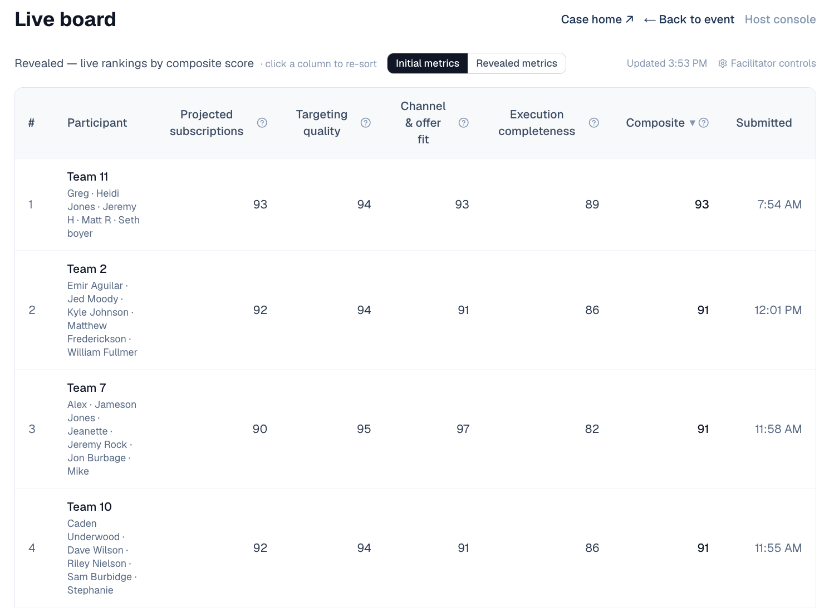
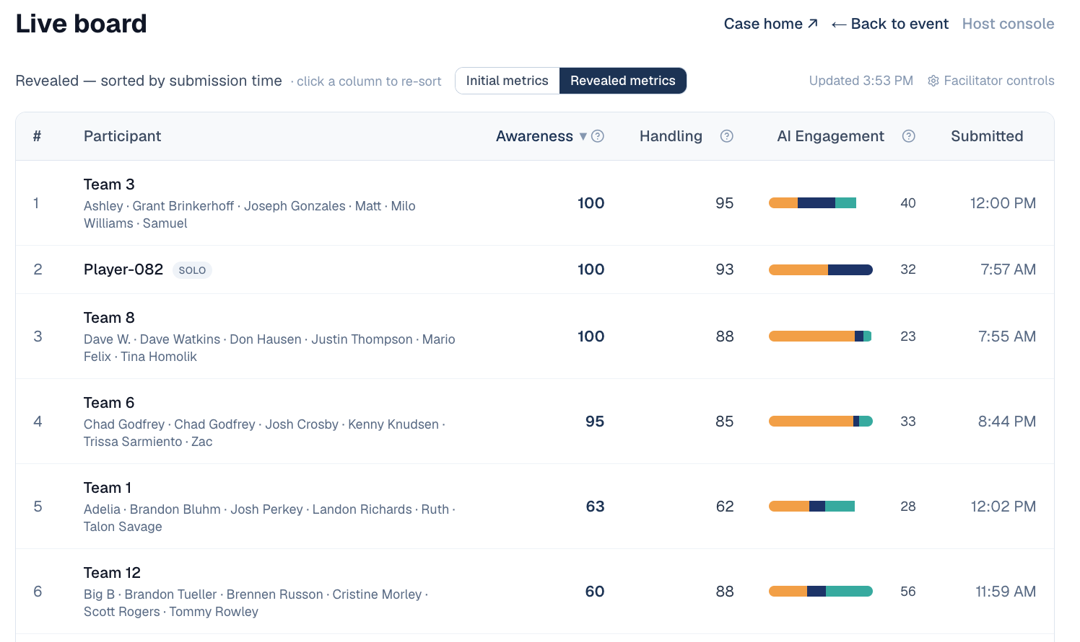
THE ACTIVITY, AS PARTICIPANTS SEE IT
The board, before and after
BEFORE · RANKED ON THE VISIBLE COMPOSITE
AFTER · RE-SCORED ON AWARENESS AND HANDLING
Polish ranked the left board. Premise-testing ranks the right one. Same submissions.
Notes:
Part of the Cabana walk-through, ~45 seconds. Point at one team that fell and one that climbed. The AI Engagement column on the after board is the third layer: how they used their AI, not just what they produced.

Slide 17
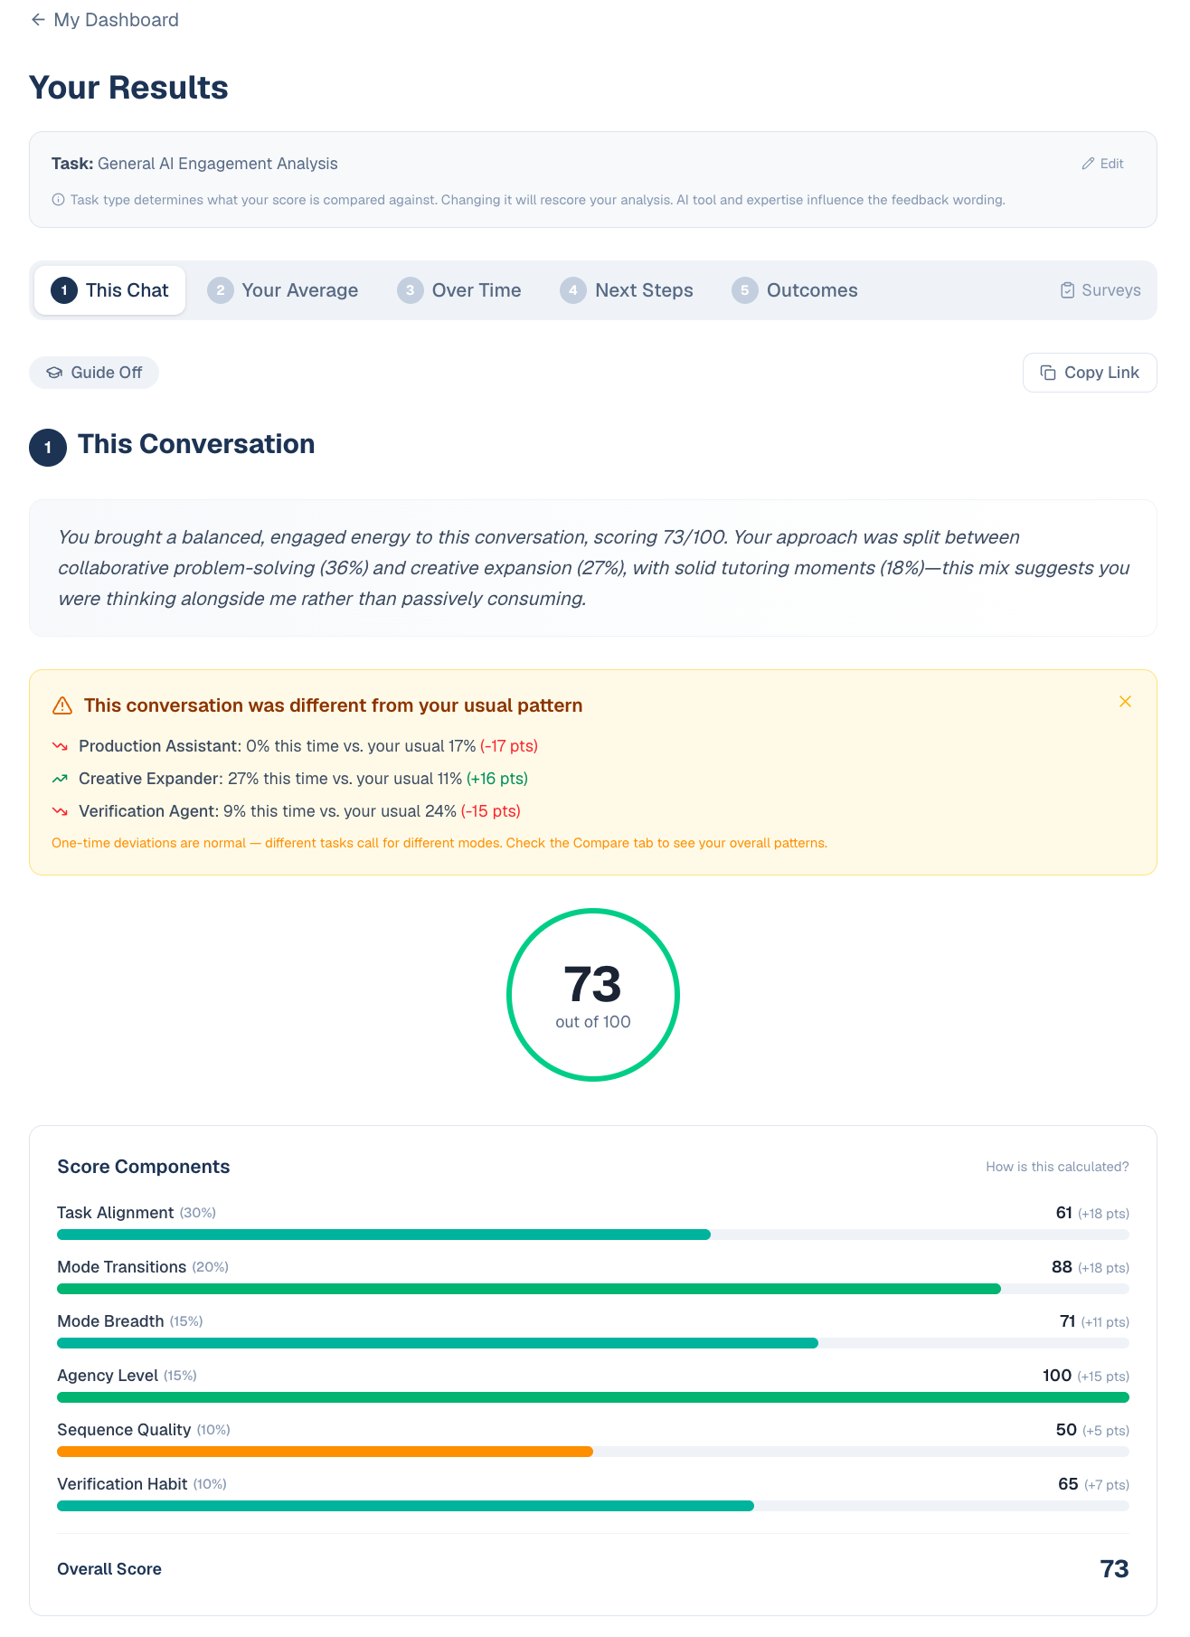
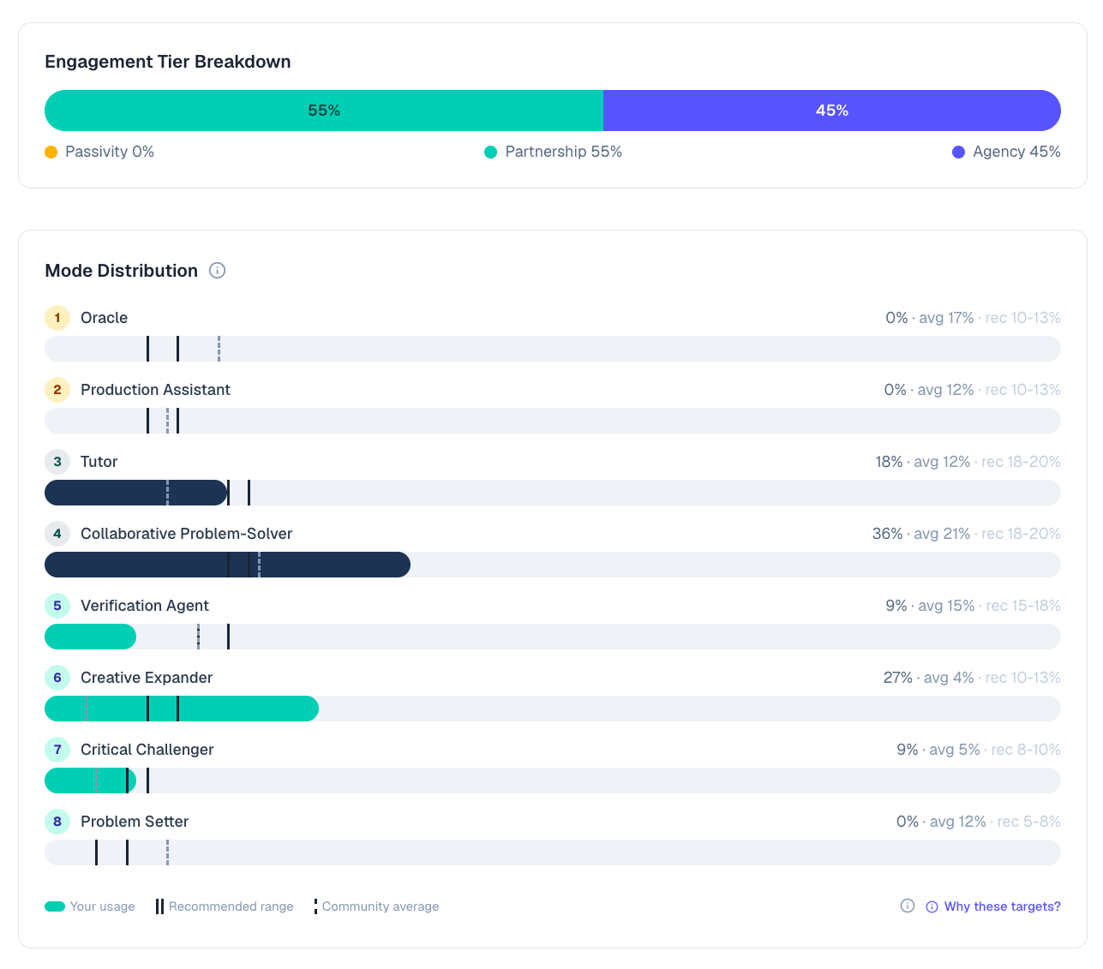
AIMODES.AI · WHAT A STUDENT SEES MINUTES AFTER SUBMITTING
The conversation, analyzed
Notes:
~45 seconds, or demo live if wifi allows. Left: overall engagement score, components, and the deviation-from-your-usual-pattern callout. Right: tier breakdown and the eight-mode distribution against recommended ranges and the community average. This is the grading engine faculty would get for their own assignments.

Slide 18
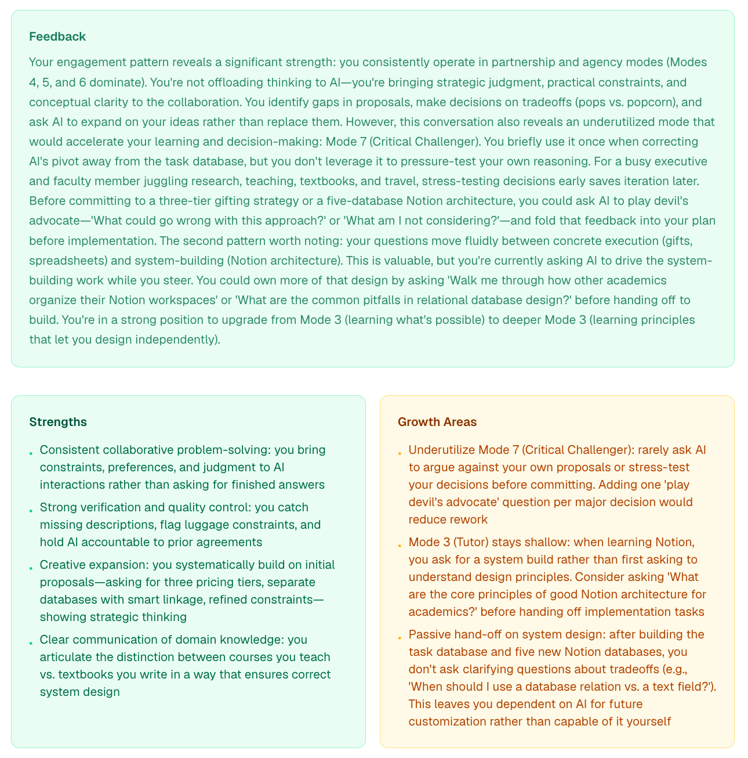
AIMODES.AI · THE PART STUDENTS ACTUALLY READ
Written feedback on every conversation
Not a score alone. Every submitted conversation gets narrative feedback, concrete strengths, and growth areas with the exact next prompt to try. The one on the right flags an underused Critical Challenger mode and hands the student the devil's-advocate question to ask next time.
This is what turns 'did they use AI' into 'how did they engage,' at scale, for every student.
Notes:
~30 seconds. Do not read the panels; the point is the depth. The feedback is task-aware and pattern-aware: it compares this conversation to the student's own history.

Slide 19


AND FOR YOUR STUDENTS, TODAY
Send them home with the same infrastructure
The Student Guide to AI-Assisted Learning
The Learn-with-AI Toolkit plugin
Tutor mode, retrieval practice, the eight modes, integrity and disclosure. 63 pages.
59 skills: socratic-tutor, teach-back-grader, exam prep, source verification. Claude plugin or Codex zip.
Both free at aimodes.ai. Drop the links in your syllabus.
Notes:
30 seconds. This is the immediately usable takeaway for faculty who teach: the guide and the toolkit keep students in tutor, verification, and challenge modes instead of copy-paste. The toolkit's socratic-tutor and teach-back-grader are the tutor-mode anchors; source-verifier is new this week. INSTALL STEPS for the syllabus, both tools. Claude: download learn-with-ai-toolkit.plugin from aimodes.ai, then Settings, Capabilities, install plugin from file. Codex: download learn-with-ai-skills-codex.zip, then in Terminal: mkdir -p ~/.codex/skills && unzip -o ~/Downloads/learn-with-ai-skills-codex.zip -d ~/.codex/skills; verify with codex --list-skills. A README with the steps is inside the zip. Same 59 skills either way.

Slide 20
FOR YOUR STUDENTS · THE ASSIGNMENT
Tutor mode, specified: six rules
Retrieval first
Socratic
“Quiz me before you teach me. Never explain what I have not first attempted.”
“Answer my question with the question that gets me there. Full solutions only after two real attempts.”
Calibration
Spacing + interleaving
“Before revealing any answer, ask my confidence. Track it and show me my calibration weekly.”
“Bring back last week's material on a schedule. Mix problem types so I cannot run on autopilot.”
Teach-back
Desirable difficulty
“Make me explain it back, then grade my explanation against the source.”
“Keep me at the edge of my ability, not inside my comfort zone.”
These six rules ARE the skill file. Students paste them as tutor-mode/SKILL.md, and every study session starts this way.
Notes:
Two minutes. Every rule is written in the student's voice on purpose: the card text IS the skill file, so the assignment is copy, paste, save, not compose. The evidence behind each rule, for when faculty ask: retrieval first is the testing effect (Roediger and Karpicke 2006; Dunlosky et al. 2013 rate practice testing and distributed practice as the two highest-utility techniques in the whole literature); Socratic questioning is how effective tutoring actually works (VanLehn 2011's review puts human and intelligent tutoring near d = .75); calibration attacks overconfidence, the metacognitive failure that makes students stop studying too early; spacing is Cepeda et al. 2006, interleaving is Rohrer's work, both beat massed practice; teach-back is self-explanation (Chi), the strongest comprehension check a learner can run alone; desirable difficulty is Bjork: learning that feels easy is usually storage without retrieval strength. AIEM tie, say it explicitly: these rules hold the student in Tutor and Challenge modes and make the Oracle slide impossible, which is the entire point of the course. THE ASSIGNMENT, verbatim for faculty to reuse: create tutor-mode/SKILL.md from these six rules, run one full study session with it, and submit the skill file plus the session transcript; grade the file on whether the CHECKS are real, grade the transcript on whether the student held the AI to them.

Slide 21
FOR YOUR STUDENTS · MAKE IT THEIRS
Tune the tutor to the learner, with evidence
Tune on what works
The measure: R-SPQ-2F
Prior knowledge. Novices get worked examples and faded scaffolding; advanced students get problem-first with hints. (The expertise-reversal effect.)
Approach to learning. Deep versus surface, measurable in ten minutes; see right.
Calibration history. Overconfident learners get confidence checks before every reveal.
Not learning styles. Visual-auditory-kinesthetic matching has no supporting evidence. Tune on knowledge, approach, and calibration instead.
Biggs, Kember & Leung (2001). 20 items, five-point scale, self-scored in ten minutes, free online. Two scores: deep approach and surface approach.
Surface-dominant: the tutor enforces retrieval and spacing strictly, and ties every topic to the student's goals.
Deep-dominant: the tutor adds extension, challenge, and transfer problems.
Score it once, paste both scores into the skill file, remeasure at midterm.
The student instruction, verbatim: take the R-SPQ-2F, then have AI write your tutor-mode skill from the six rules, tuned to your scores.
Notes:
Two minutes. Theory first, honesty second, procedure third. THEORY: the evidence-based tuning variables are prior knowledge (worked examples help novices and hurt experts, the expertise-reversal effect, Kalyuga et al. 2003), approach to learning (Biggs), and metacognitive calibration; the framework for the whole slide pair is self-regulated learning (Zimmerman): plan, monitor, adjust. HONESTY, and faculty will respect this: learning-styles matching (visual, auditory, kinesthetic) has no adequate supporting evidence; Pashler, McDaniel, Rohrer and Bjork's 2008 review found none, so we tune on what does have evidence. The R-SPQ-2F itself has some psychometric debate at the item level; use it as a reflection and tuning input, not as a label that tracks a student. THE STUDENT PROCEDURE, verbatim for the syllabus: 1 Download the R-SPQ-2F (free, on John Biggs's site, johnbiggs.com.au) and answer the 20 items honestly about THIS course. 2 Score it: sum the ten deep-approach items and the ten surface-approach items per the key on the form. 3 Prompt your AI: Here are six tutor rules [paste the previous slide] and my R-SPQ-2F scores, deep [x] and surface [y]. Write tutor-mode/SKILL.md for [course]: the six rules, plus tuning: if my surface score is higher, enforce retrieval and spacing strictly and tie each topic to my goals; if my deep score is higher, add extension and transfer problems past the syllabus. Include WHEN TO USE: every study session for this course. 4 Save it: in Claude, Settings, Capabilities, Skills; in any other AI, keep it pasted at the top of study sessions. 5 Remeasure at midterm and let the AI update the tuning. Deliverable to the instructor: the SKILL.md plus one session transcript.

Slide 22

Use it in your own class
The analyzer: Students paste a real AI conversation and get their eight-mode profile in minutes. Free.
Class activities: Eight reusable activity types. The Flip is built; four more are specified. I will run the first one in your class with you.
The grading path: Transcript-as-submission plus mode classification turns 'did they use AI' into 'how did they engage.'
aimodes.ai/a/MSB26
Try the Cabana case yourself, this week, the way students will.
Teach them to be the 3 in 10.
Mark Keith · mark.keith@byu.edu · aimodes.ai
Notes:
20:00-22:00. The MSB26 session stays open all week so faculty can experience the case themselves. Close on the line and hand off. Buffer lives here: if running late, this slide is 60 seconds.

